Slide 1
Employee Data Analysis using Excel
Harini. R
STUDENT NAME:
REGISTER NO:
DEPARTMENT:
COLLEGE
312208308 ECF9D5C754C22BB9812428851465EE
B.Com ( General )
Chellammal Women's College

Slide 2
PROJECT TITLE
Employee Performance Analysis using Excel

Slide 3


AGENDA
Problem Statement
Project Overview
End Users
Our Solution and Proposition
Dataset Description
Modelling Approach
Results and Discussion
Conclusion
3/21/2024 Annual Review

Slide 4

PROBLEM STATEMENT
Employee performance analysis is used to evaluate employee performance against company expectations and to improve performance

Slide 5

PROJECT OVERVIEW
Employee analysis the performance of the employee by consider various factors like gender, performance score,rating achievement performance analysis involves the systematic evaluation of employee productivity , efficiency and effectiveness within an organization. This process helps identify strengths , weakness and areas for improvement . Enable informed decision making and targeted intervention to enhance overall organisational performance
.

Slide 6

WHO ARE THE END USERS?
Employees
Employers
Organisations
Industries

Slide 7
OUR SOLUTION AND ITS VALUE PROPOSITION
Filtering - To remove missing values
Conditional formatting - To highlight blank values
Pivot table- Summary of employee performance
Formula - performance
Graph- Visualisation

Slide 8
Dataset Description
Employee - kaggle
26- features
10- features
Employee - ID
First name
Last name
Business unit
Employee status
Employee type
Employee classification type
Gender
Performance score
Current employee rating

Slide 9
THE "WOW" IN OUR SOLUTION
Performance level= IFS(J2>5, “ Very high" , J2>4, " High”, J2>3, “MED", " TRUE “, " LOW”)
3/21/2024 Annual Review
‹#›

Slide 10
MODELLING
Data Collection
Kaggle - Employee
Login
Employees data colect
Features Collection
26 features
Select 10 features
*Employee ID
*First name
* Last name
* Business unit
*Employee status
*Employee type
* Employee classification type
* Gender
* Performance score
* Current employee rating
* Performance analysis value
‹#›

Slide 11
Data cleaning
Select filter option
Insert Colour
Select no file
Summary
Auto file
Graphs & chart
Data collect & analysis
Visualization
Dashboard creation
Conditional formatting
Pivot tables
Trend analysis

Slide 12
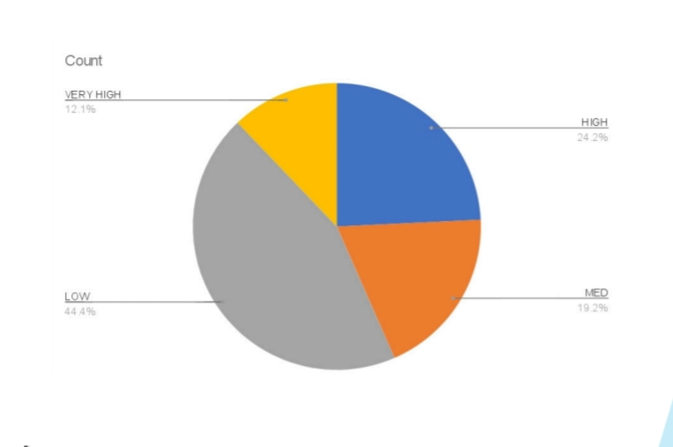
RESULTS
‹#›

Slide 13
conclusion
This distribution provides a comprehensive overview of how employees are performing across different levels, highlighting areas of strength and areas needing improvement within the organisation .
And motivated the low performance employee because they high members of the data so motivated the low performance employee

